Slide 1

Case Study: Google Maps Recommendation System
Google Maps is a powerful navigation and location-based service that leverages advanced machine learning algorithms to provide users with a seamless and personalized experience. This presentation will delve into the key machine learning techniques that power the recommendation system within Google Maps.

Slide 2
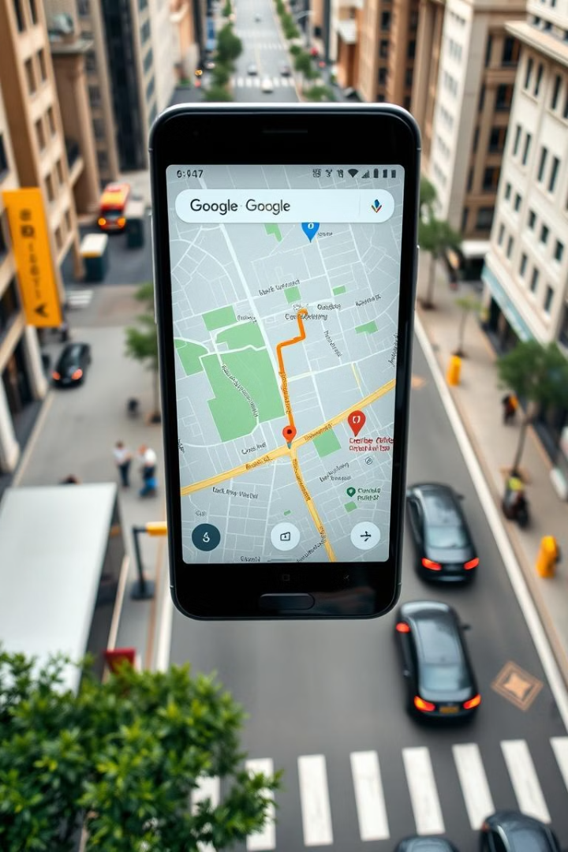
Introduction to Google Maps
1
Comprehensive Mapping
2
Recommendation Features
Google Maps provides detailed maps and satellite imagery of the entire world, covering both urban and rural areas.
The app offers a range of personalized recommendations, including nearby points of interest, popular places, and real-time directions.
3
User-Centric Design
The interface is designed to be intuitive and user-friendly, making it easy for users to navigate and discover new locations.

Slide 3
Machine Learning Algorithms in Google Maps
Supervised Learning
Unsupervised Clustering
Neural Networks
Google Maps uses supervised learning techniques to provide personalized location recommendations based on user preferences and behavior.
Unsupervised clustering algorithms help identify popular places and trends by grouping similar locations and user activities.
Deep neural networks power the real-time routing and traffic prediction features, enabling users to navigate efficiently.

Slide 4
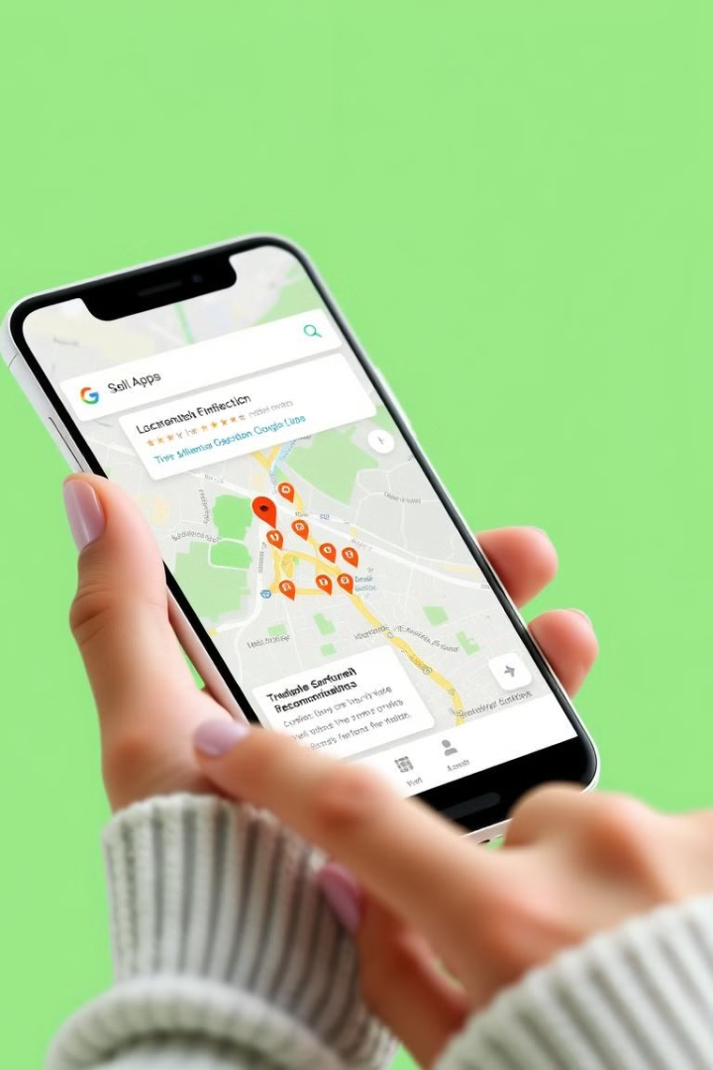
Supervised Learning for Location Recommendations
1
User Preferences
Google Maps analyzes user search history, location data, and browsing patterns to understand their preferences and interests.
2
Predictive Modeling
Supervised learning algorithms create predictive models to match users with relevant locations, attractions, and businesses.
3
Personalized Suggestions
The recommendation system provides users with tailored suggestions for nearby places, based on their individual profiles and behavior.

Slide 5

Unsupervised Clustering for Popular Places
Aggregating User Data
Unsupervised Clustering
Google Maps collects and analyzes vast amounts of user location data to identify popular and trending places.
Algorithms group similar locations and user activities, revealing patterns and insights about the most frequented spots.
Trending Recommendations
Continuously Updating
The recommendation system leverages these insights to surface popular and trending places, helping users discover new destinations.
The system is designed to adapt and evolve, ensuring that the recommendations stay relevant and up-to-date.

Slide 6
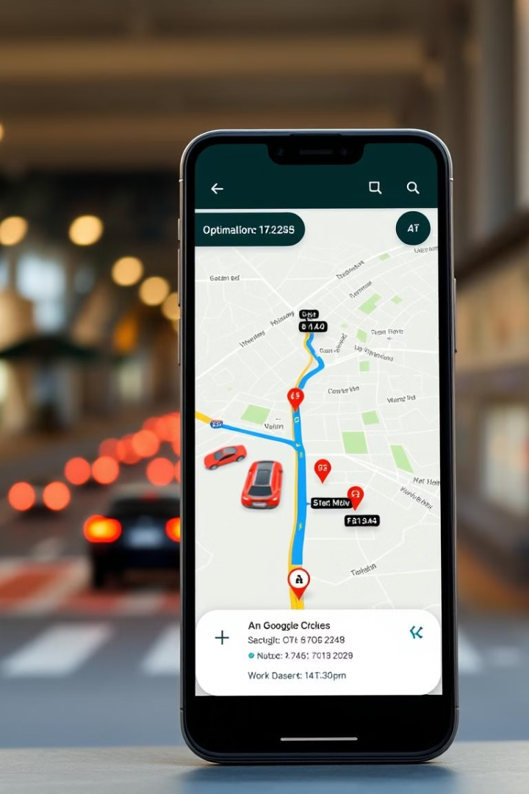



Neural Networks for Real-Time Routing
Traffic Data Collection
Google Maps gathers real-time data from various sources, including user location data and traffic sensors.
Neural Network Analysis
Deep neural networks analyze the collected data to predict traffic patterns and identify the fastest routes.
Dynamic Routing
The recommendation system provides users with the most efficient and up-to-date directions, factoring in real-time traffic conditions.

Slide 7




Ethical Considerations
Data Privacy
Ensuring user data is collected, stored, and used responsibly, with robust security measures in place.
Ethical AI
Developing the recommendation system with a focus on fairness, transparency, and accountability.
Inclusive Design
Ensuring the app's features and recommendations cater to diverse user needs and backgrounds.

Slide 8
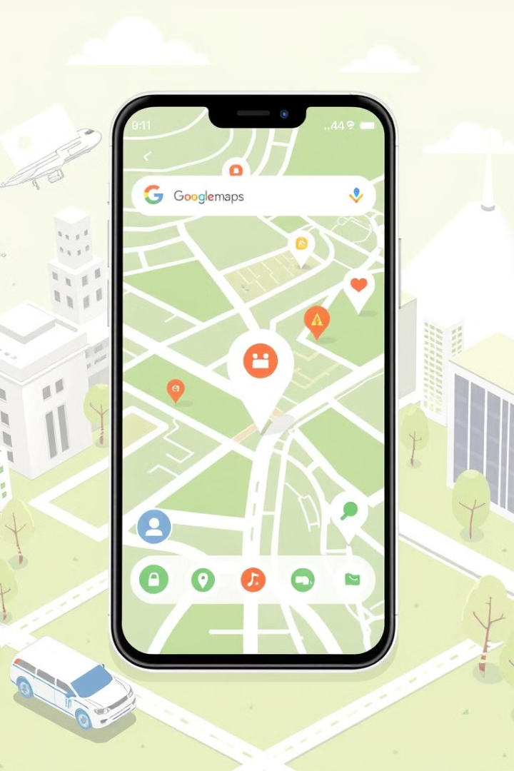
Challenges and Future Developments
1
Scalability
2
Edge Computing
Handling the ever-increasing volume of user data and location information while maintaining low latency and high performance.
Leveraging edge computing to enable real-time processing and personalization closer to the user's device.
3
Multimodal Integration
4
Augmented Reality
Incorporating augmented reality features to enhance the user experience and provide more immersive navigation.
Seamlessly integrating different transportation modes, such as public transit, ride-sharing, and autonomous vehicles.

Slide 9
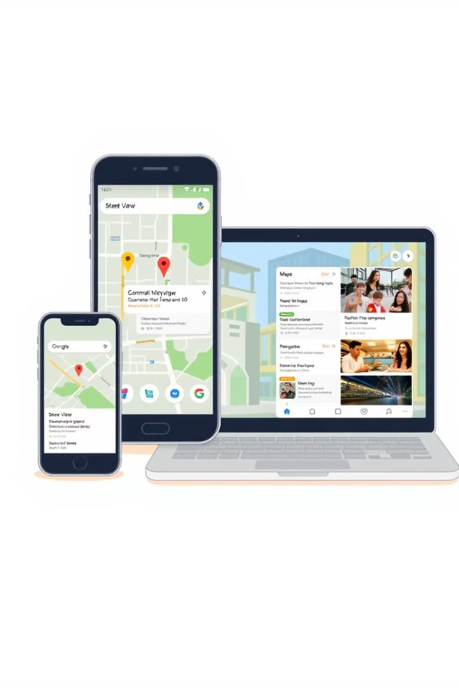
Conclusion
Google Maps' recommendation system leverages advanced machine learning algorithms to provide users with a tailored and efficient navigation experience. By combining supervised learning, unsupervised clustering, and neural networks, the system continuously evolves to meet the changing needs of users while adhering to ethical principles.

Slide 10

Q&A
Thank you for your attention. I'm happy to answer any questions you may have about the machine learning algorithms and recommendation features used in Google Maps.

